Slide 1

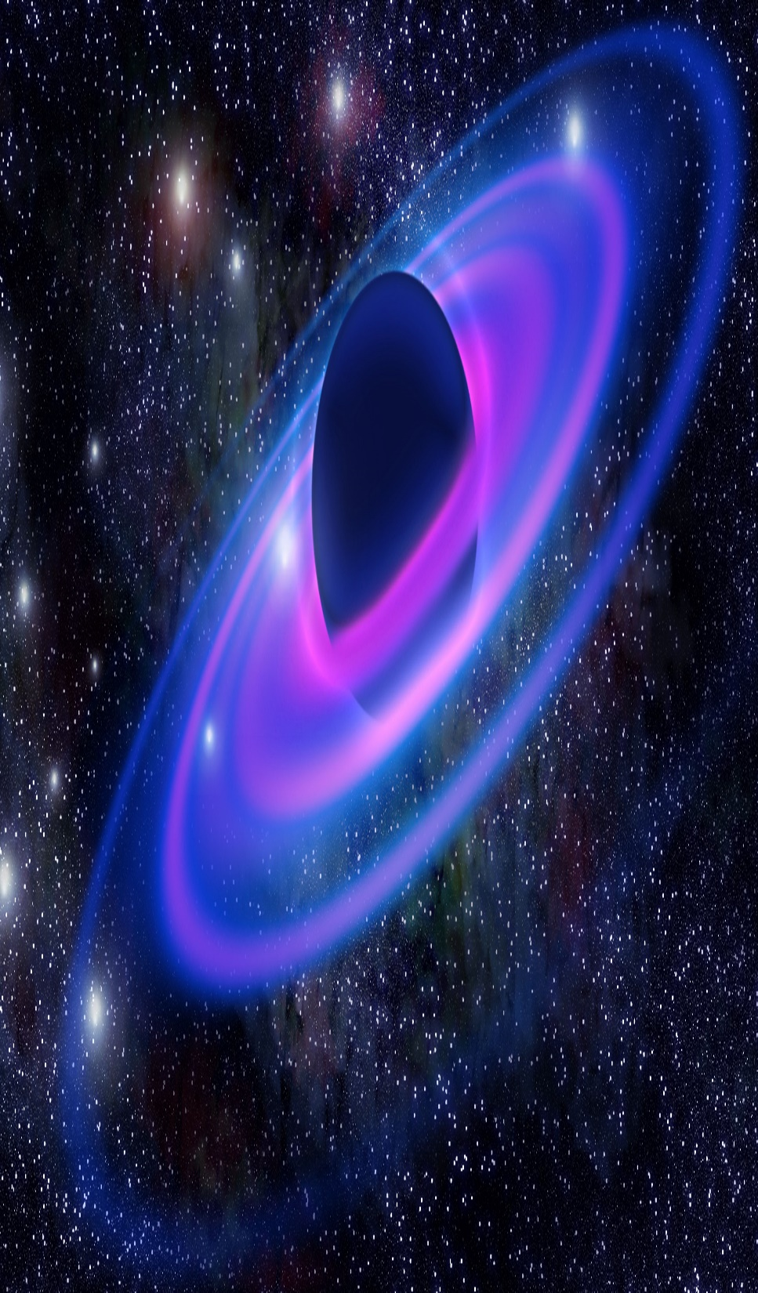
Chapter 1:
The Origin of the Universe:
Word list

Slide 2

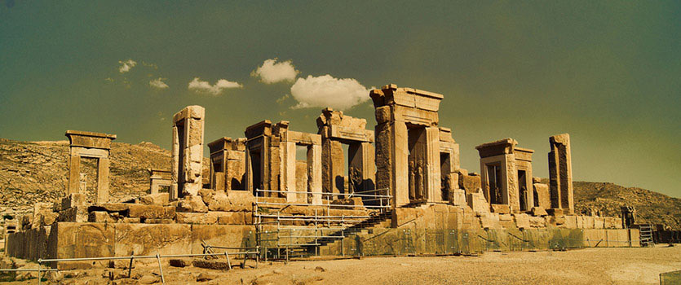
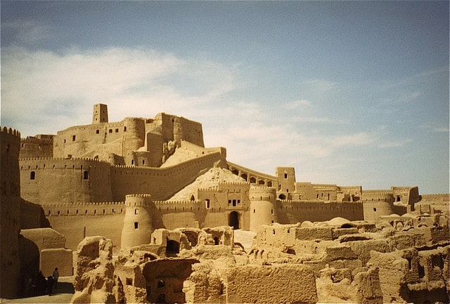
Ancient (Adj) /ˈeɪn.ʃənt/
Old: belonging to a very distant past
The ancient civilizations
The ancient monuments in Iran

Slide 3
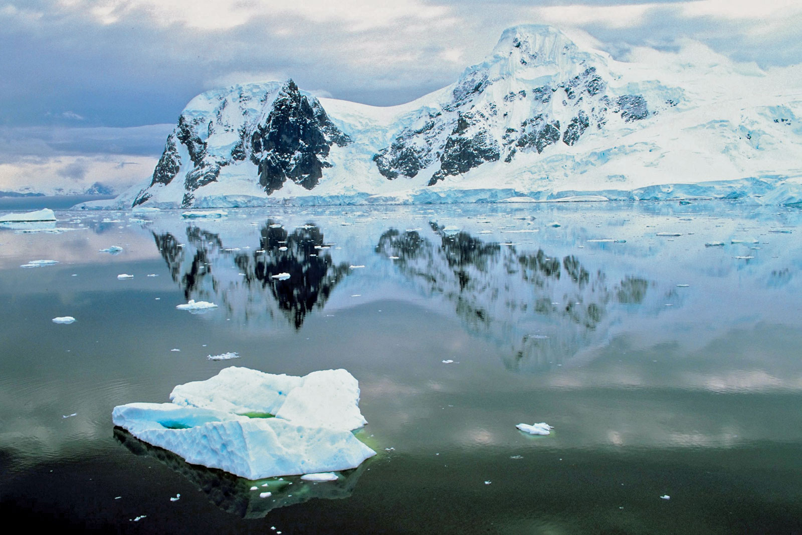
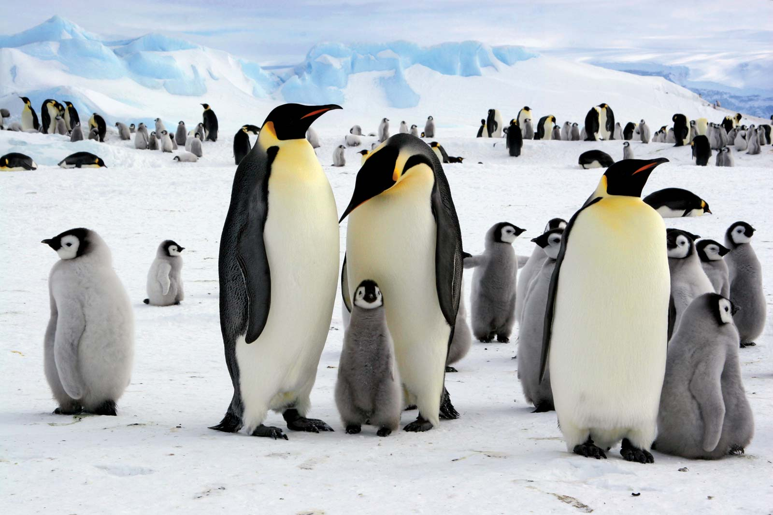
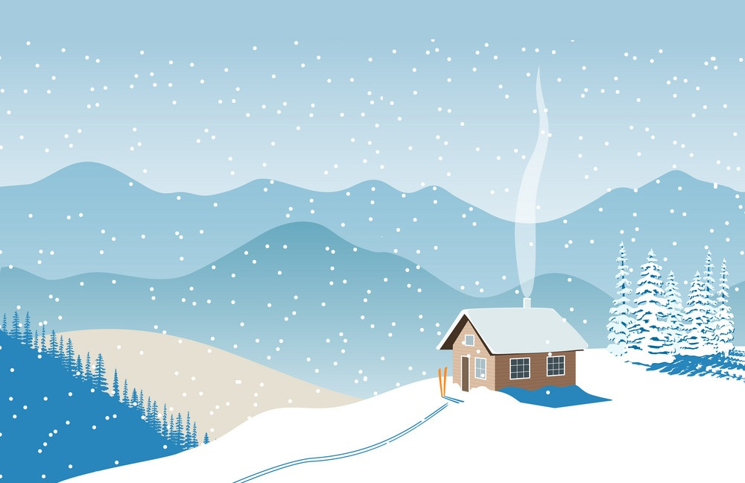
Antarctica (N.) /ænˈtɑːrk.tɪ.kə/
The continent around the south Pole
In Antarctica, there is no sunshine between April and August.
In one hour, penguins can only walk about three kilometers across the ice of Antarctica.

Slide 4
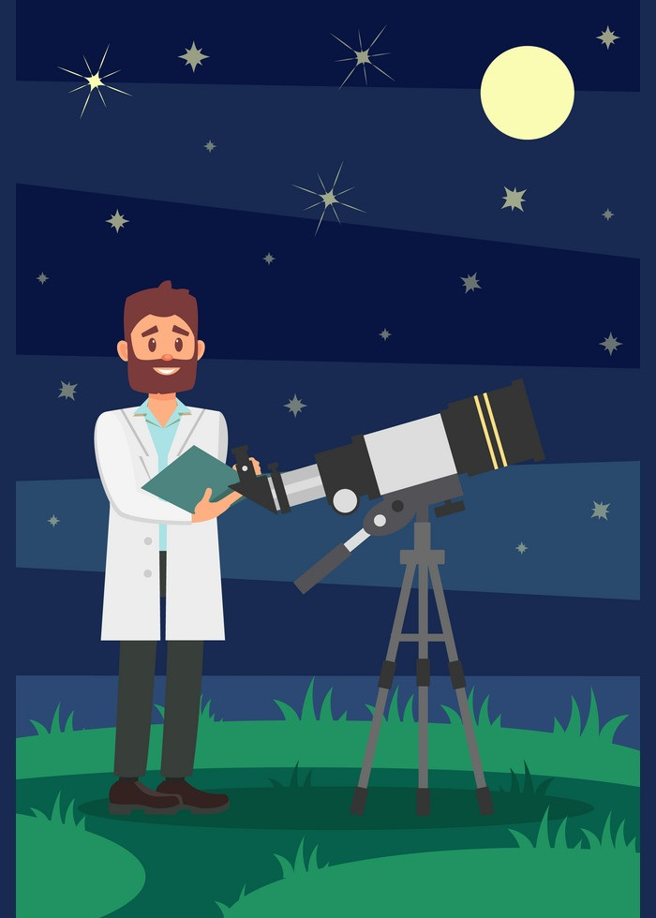

Astronomer (N) /əˈstrɑː.nə.mɚ/
Someone who studies astronomy (the scientific study of the universe space, such as the moon, includingthe sun, planets, and stars)
Astronomers, the scientists who study space and planets, decided that Pluto was too small and too far away from our sun to be called a planet.
Recently, astronomers watched a star falling into a black hole.

Slide 5
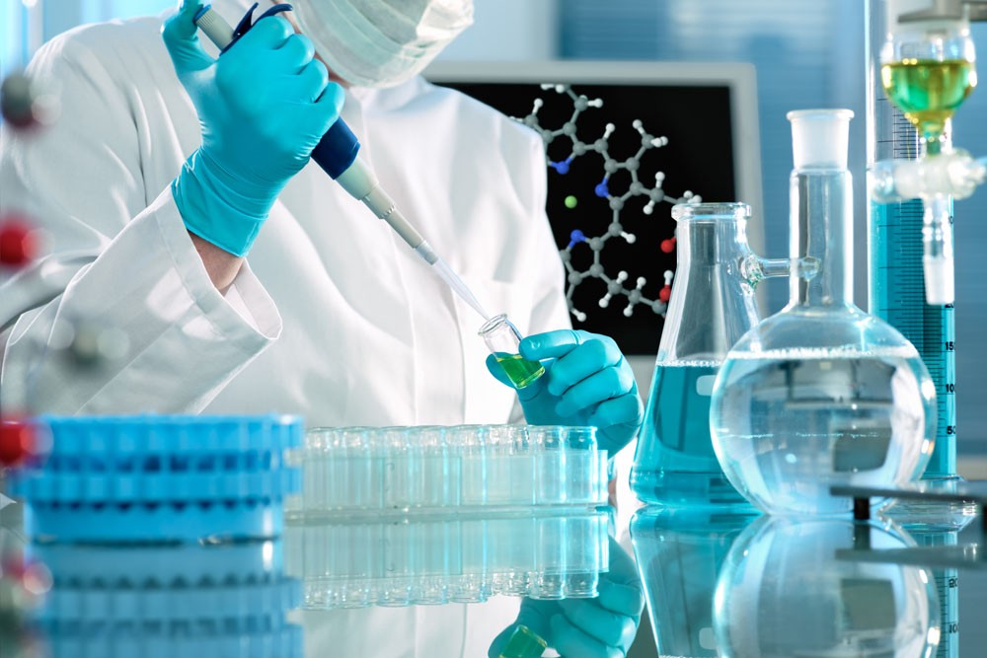
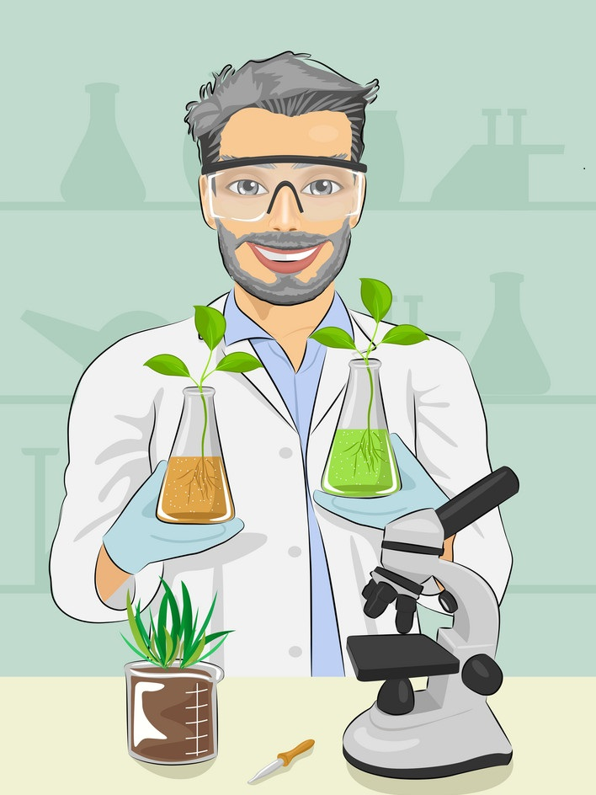
Biologist (N) /baɪˈɑː.lə.dʒɪst/
A scientist who studies the natural processes of living things.
Thanks to new technology such as submarines, biologists in the 20th century were able to discover and record the existence of many amazing creatures.

Slide 6

Boundary (N) /ˈbaʊn.dər.i/
1. a dividing line
The boundary of the country
2. the limit of a subject:
The blurring boundaries between IT Engineering and Computer Science

Slide 7
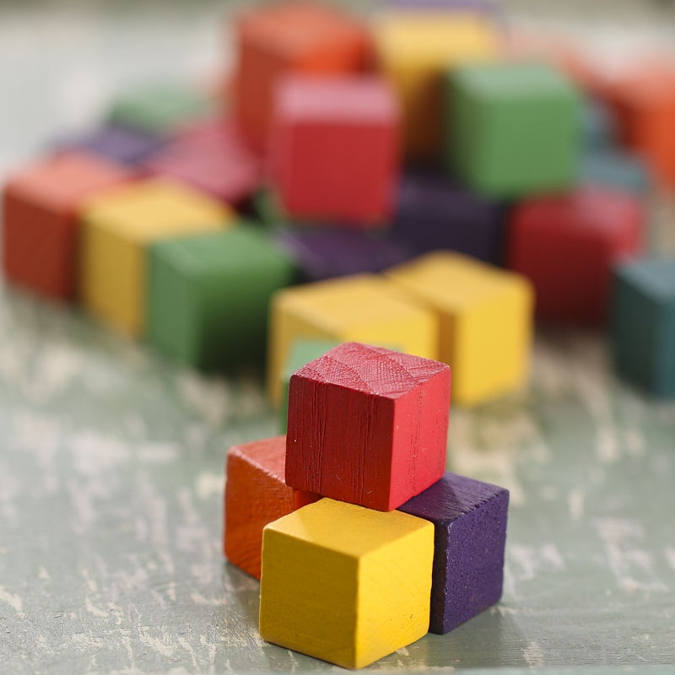
Building block (N) /ˈbɪl.dɪŋ ˌblɑːk/
The basic things that are put together to make something exist:
Sounds are the building blocks of any language.

Slide 8
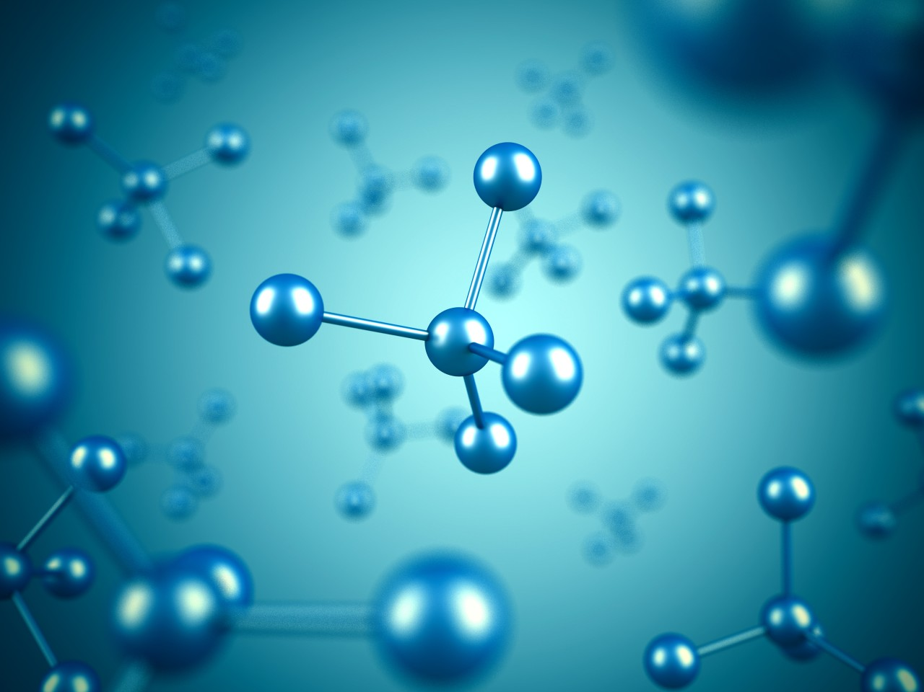
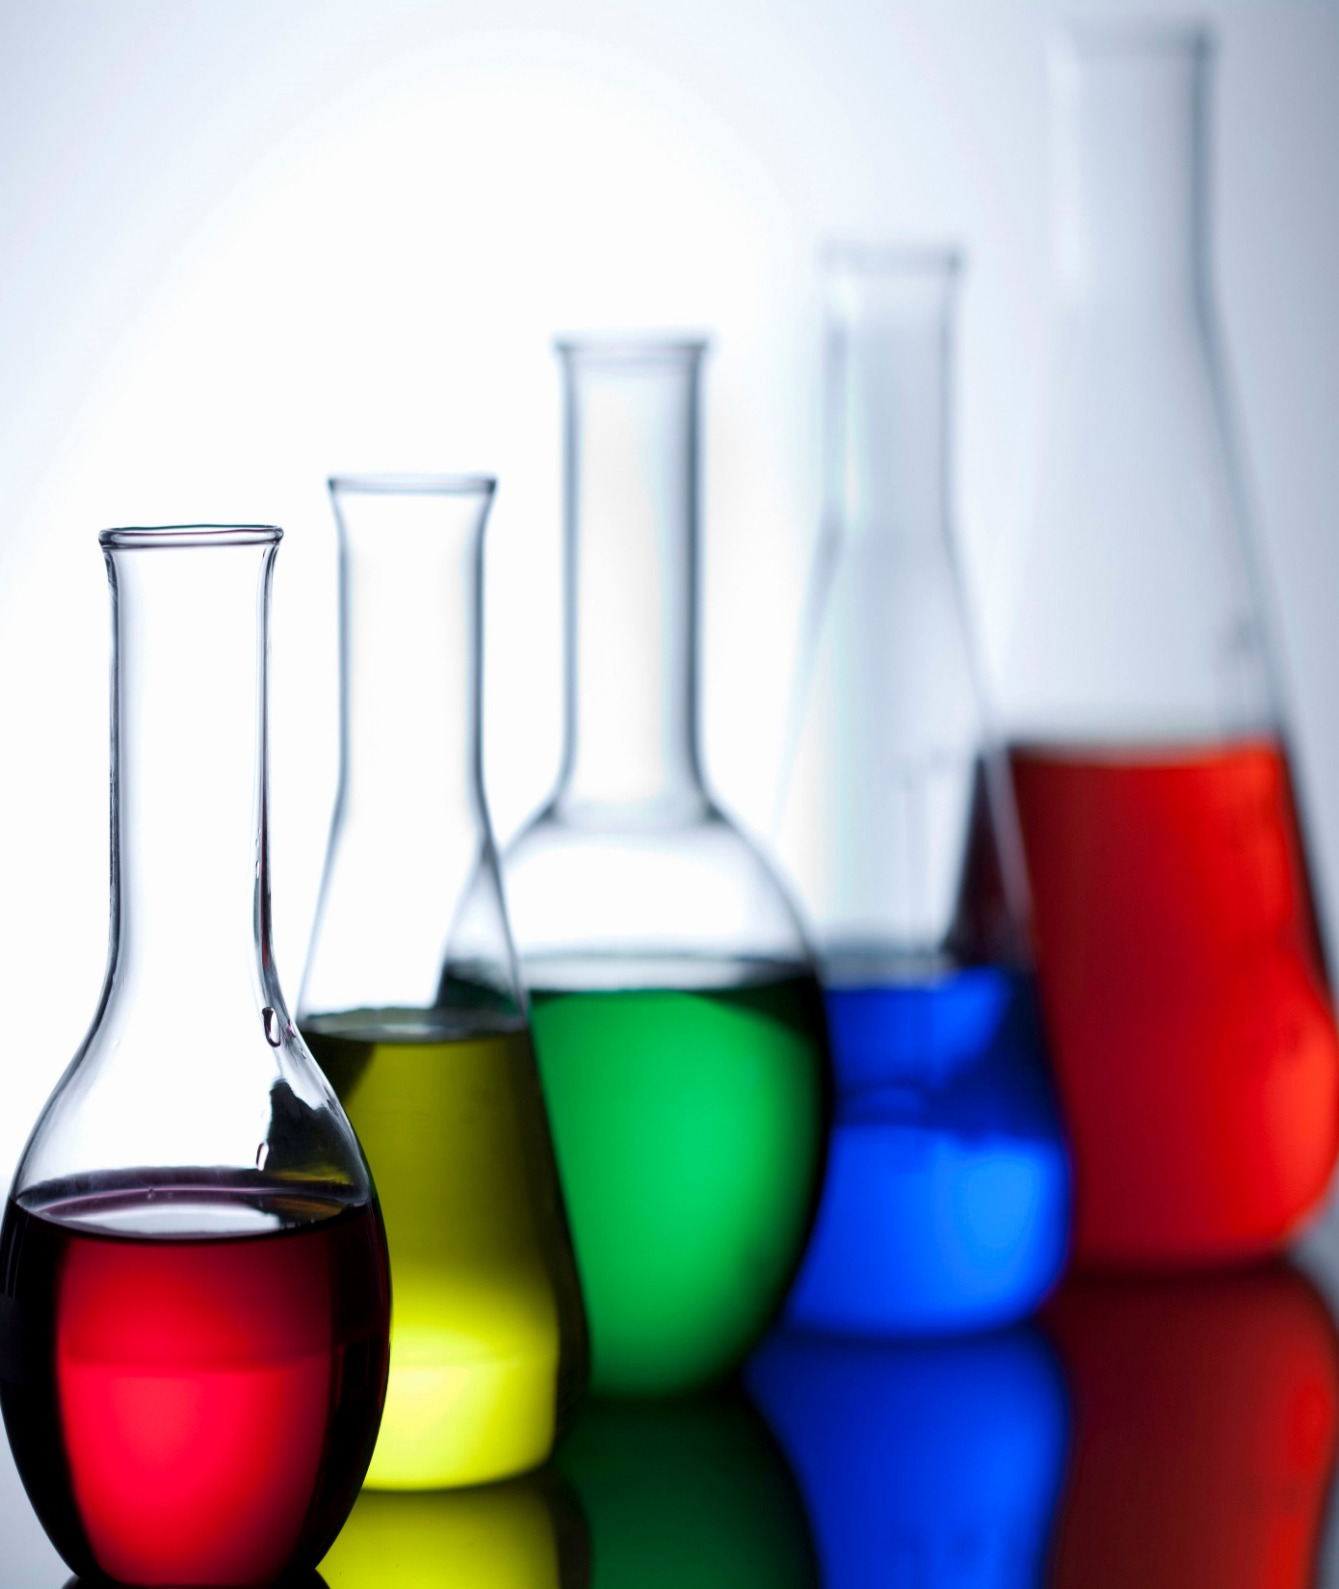
Chemical (N) /ˈkem.ɪ.kəl/
Interaction of substances:
Factories annually produce millions of chemicals into the atmosphere.

Slide 9
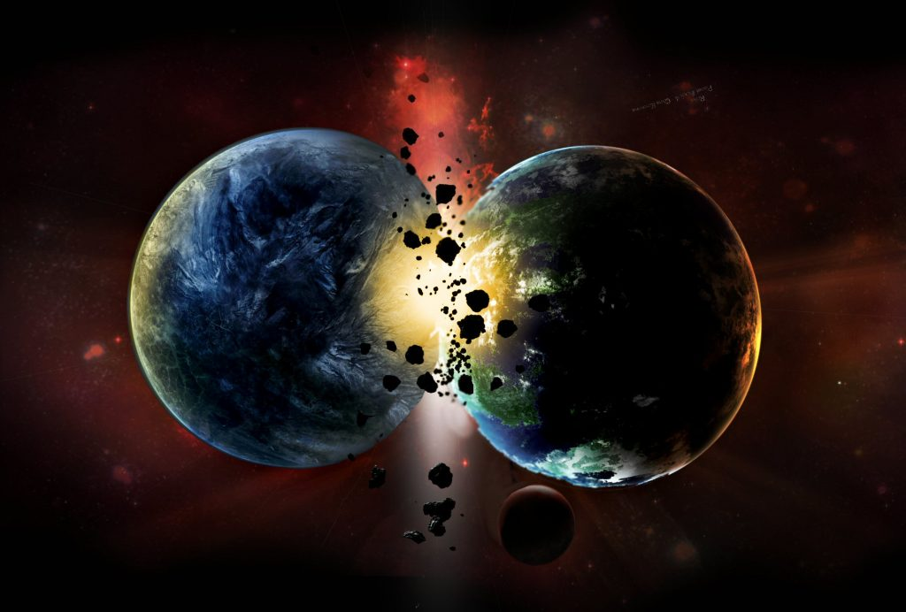
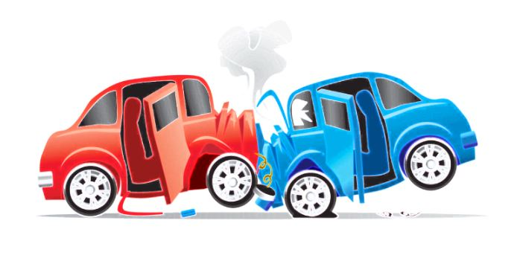
Collide (N) /kəˈlaɪd/
Hit by accident when moving:
The two cars collided at the crossroad.
It was predicted that a comet would collide with one of the planets.

Slide 10
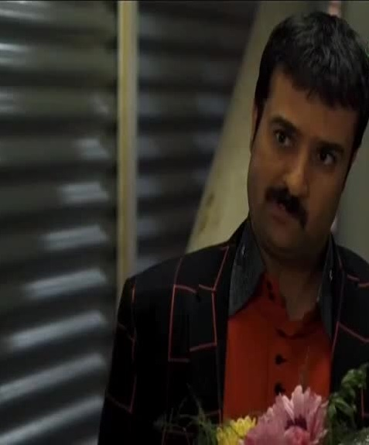
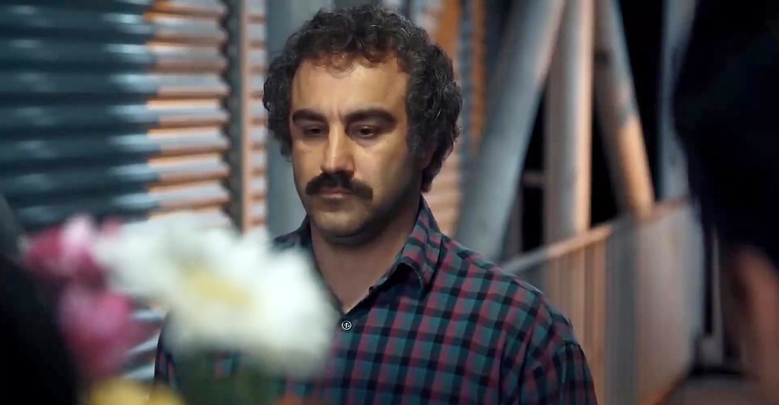
Coincidence (N) /koʊˈɪn.sɪ.dəns/
when two or more things surprisingly happen at the same time:
You chose exactly the same wallpaper as us - what a coincidence!

Slide 11
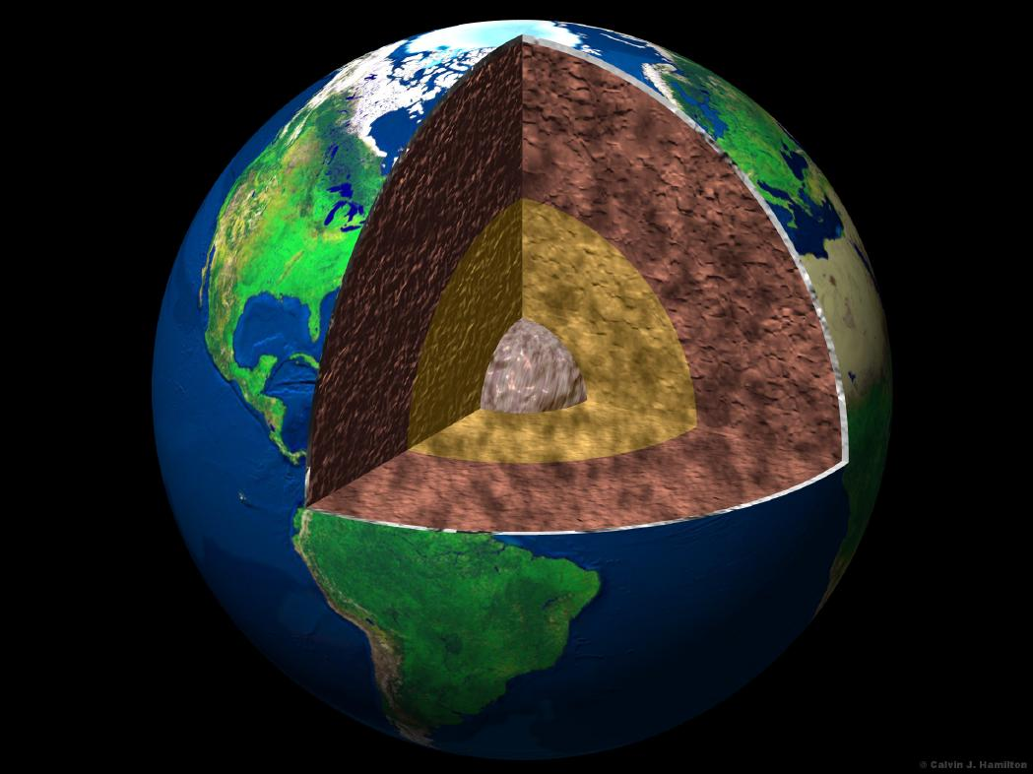
Crust (N)
/krʌst/
a hard outer covering of something:
The Earth's crust

Slide 12
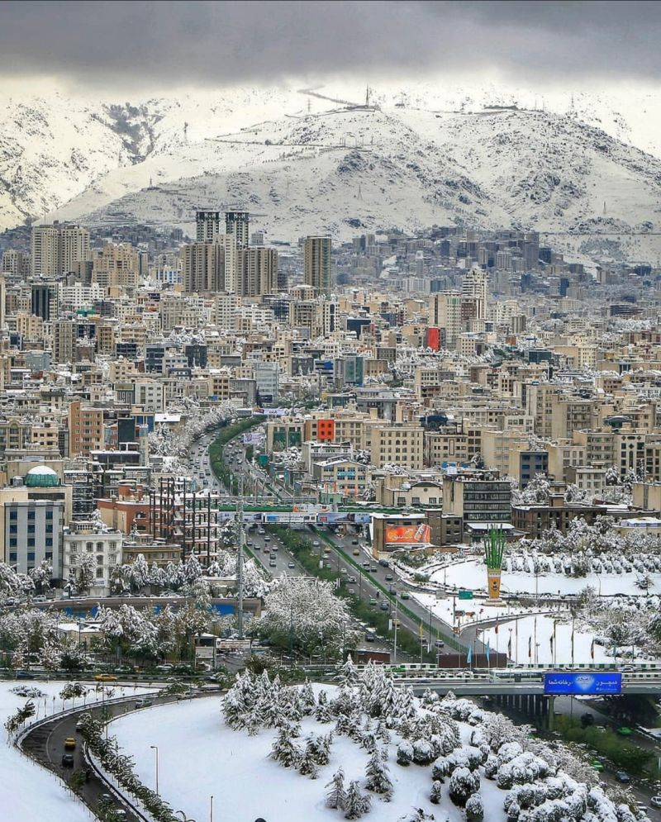


Dense (Adj) /dens/
Thick and compact
Dense atmosphere

Slide 13
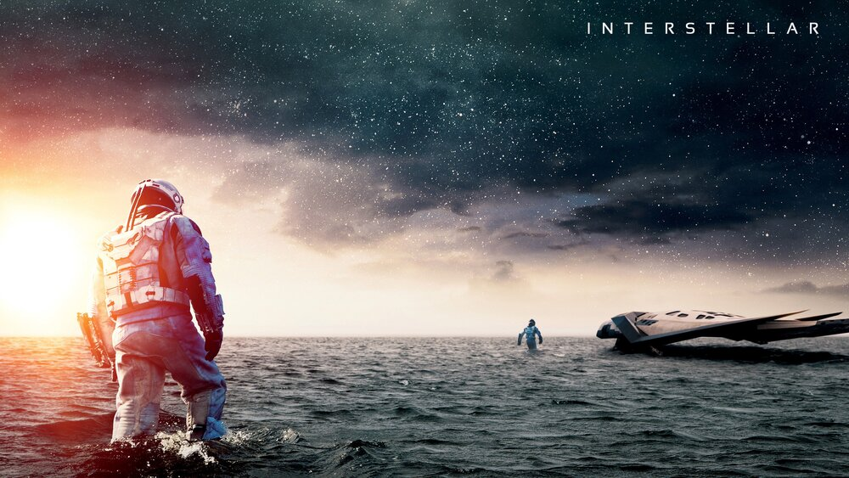
Distant (Adj) /ˈdɪs.tənt/
far away, remote
a distant planet

Slide 14
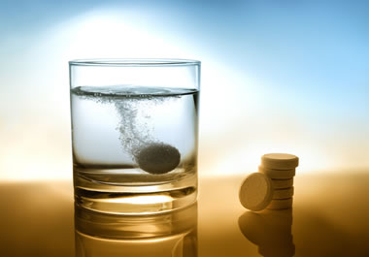
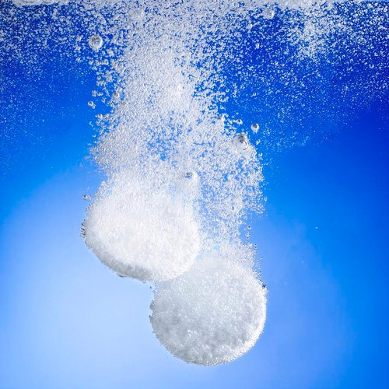
Dissolve (V) /dɪˈzɑːlv/
(of a solid) to be absorbed by a liquid
Dissolve two spoons of powder in warm water.
Nitric acid will dissolve most animal tissue.

Slide 15

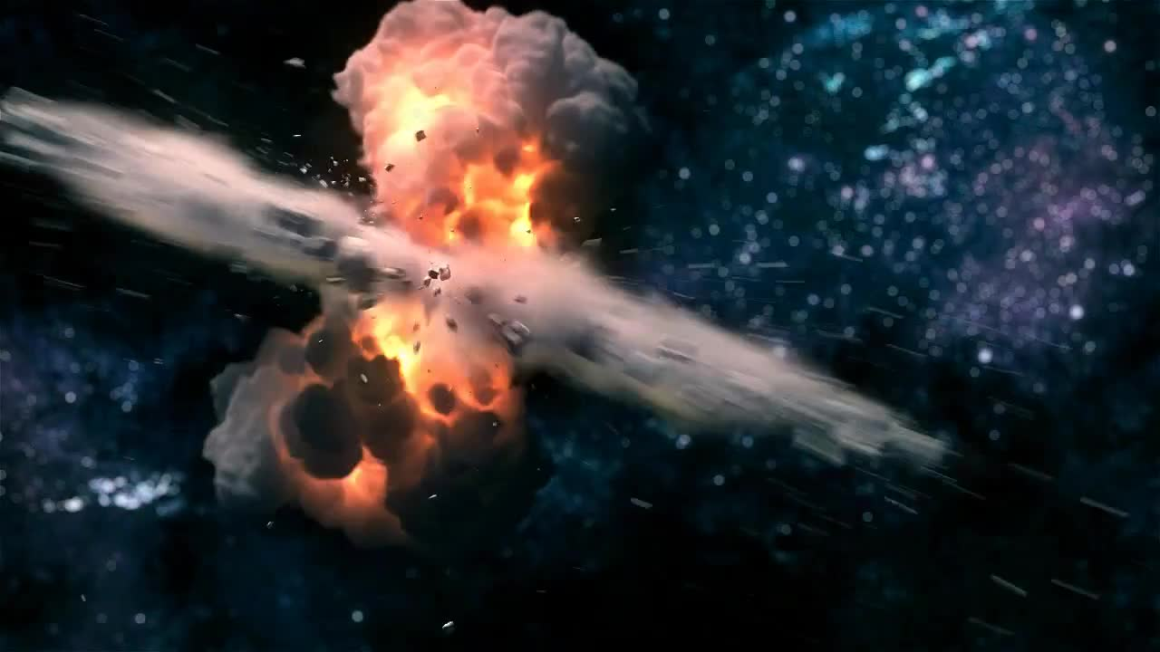
Explosion (N) /ɪkˈsploʊ.ʒən/
A violent burst
The fire was thought to have been caused by a gas explosion.
Fortunately, there was no one in the house at the time of the explosion.
Explosion

Slide 16


Explanation (N) /ˌek.spləˈneɪ.ʃən/
The act of explaining
Could you give me a quick explanation of how to learn Python?

Slide 17
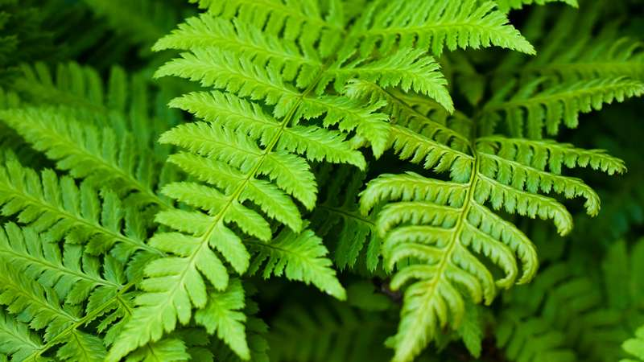
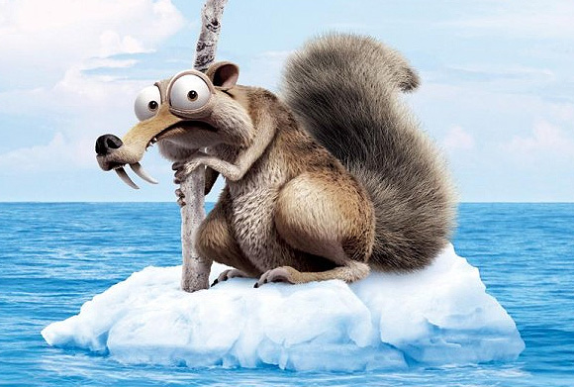
Fern (N) /fɝːn/
A green plant with long stems, leaves like feathers, and no flowers
Drift (V) /drɪft/
To be carried slowly by a current of water
No one noticed that the boat had begun to drift out to sea.

Slide 18
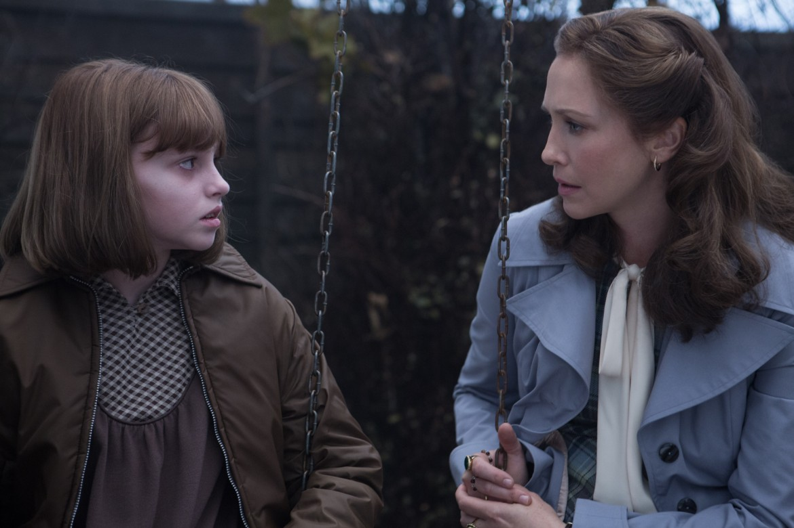
Faint (Adj) /feɪnt/
Slight, not clear
We heard faint strange noises upstairs.

Slide 19
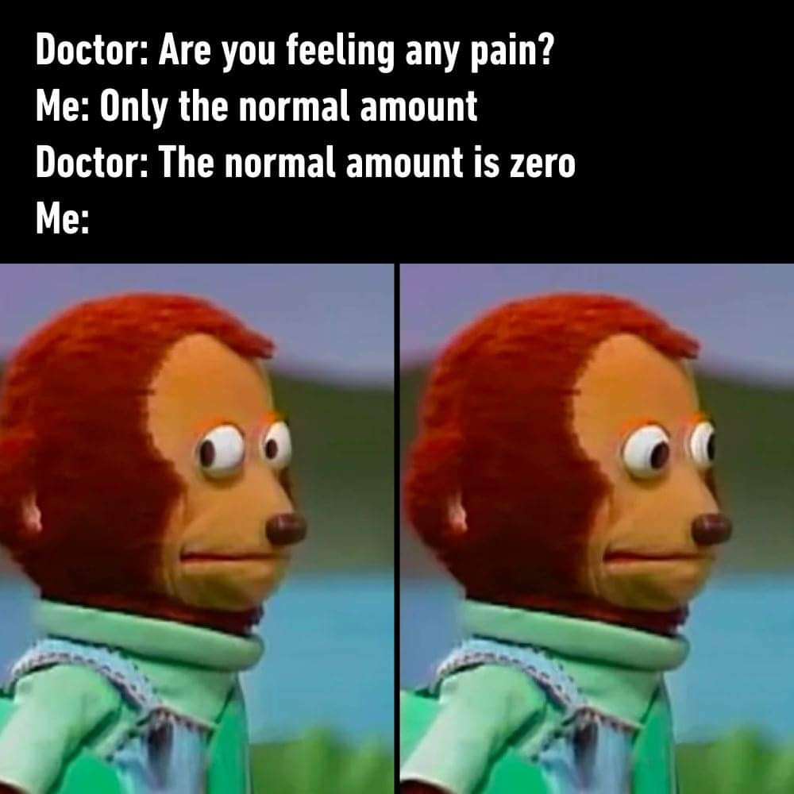
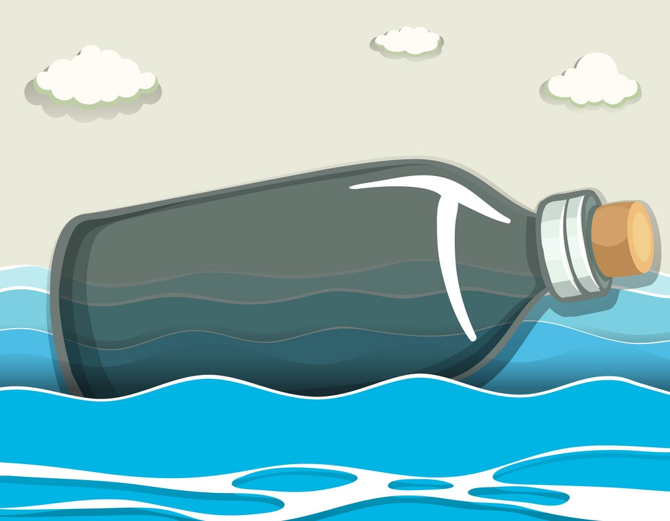
Fairly (Adv) /ˈfer.li/
less than very: quite
I'm fairly sure that this is the right address.
Float (V) /floʊt/
To stay on the surface of a liquid and not sink:
An empty bottle will float.

Slide 20
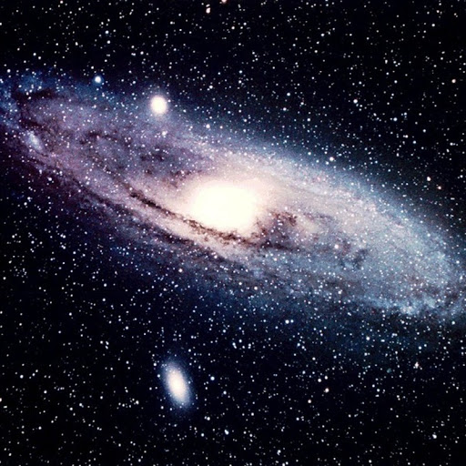
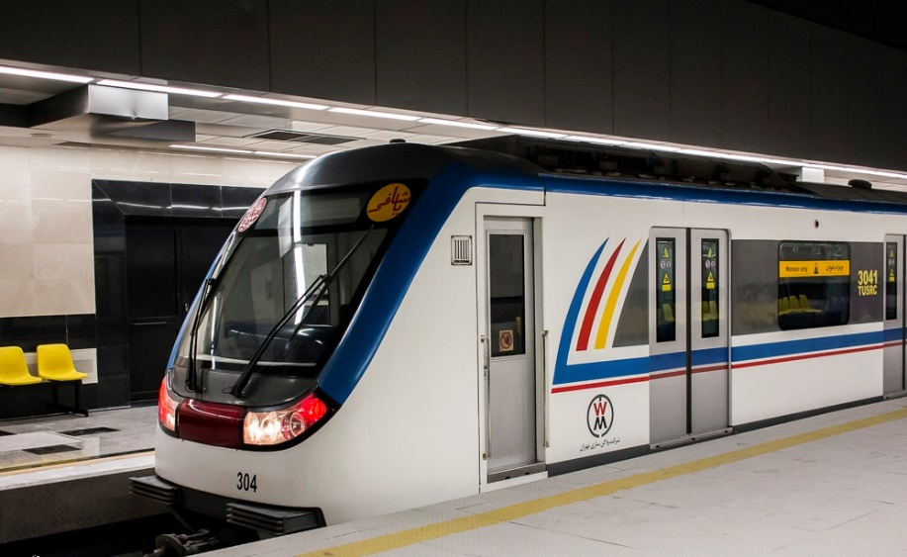
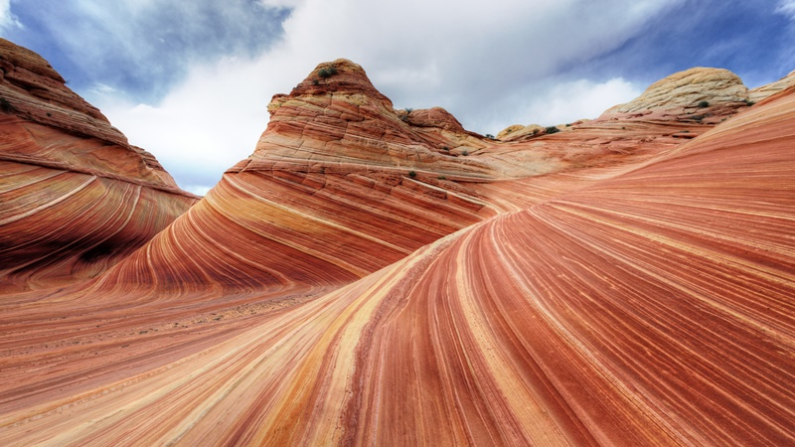
Galaxy (N) /ˈɡæl.ək.si/
Large groups of stars and planets
Gap (N) /ɡæp/
An empty space in the middle of something or between two things:
Geological (Adj) /ˌdʒi.əˈlɑː.dʒɪ.kəl/
Relating to geology:
The complex geological structure of the region
Mind the gap

Slide 21
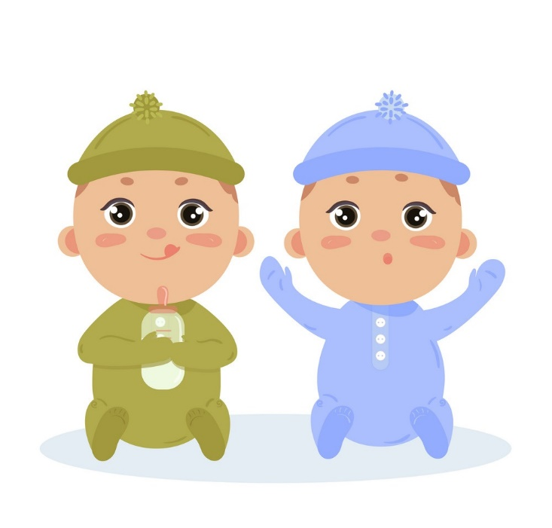
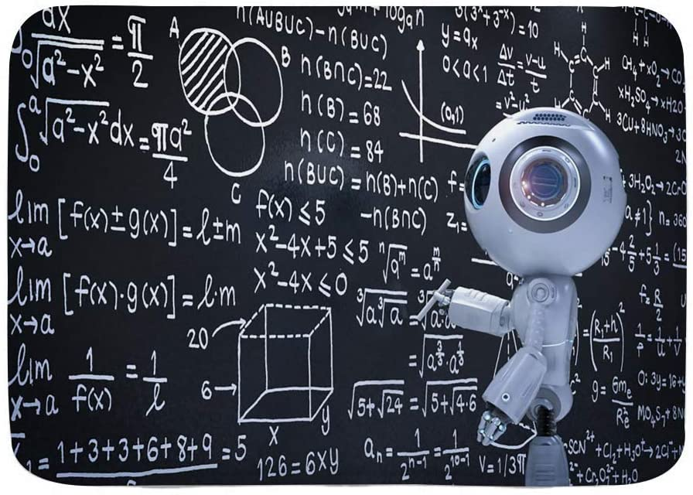
Identical (Adj) /aɪˈden.t̬ə.kəl/
Exactly the same, or very similar
The twins are identical.
The tests are identical to those carried out last year.
Imply (V) /ɪmˈplaɪ/
Indirectly express: indicate: suggest
The report implied that the national economy could be slowing down.
Who do all these formulas imply?

Slide 22
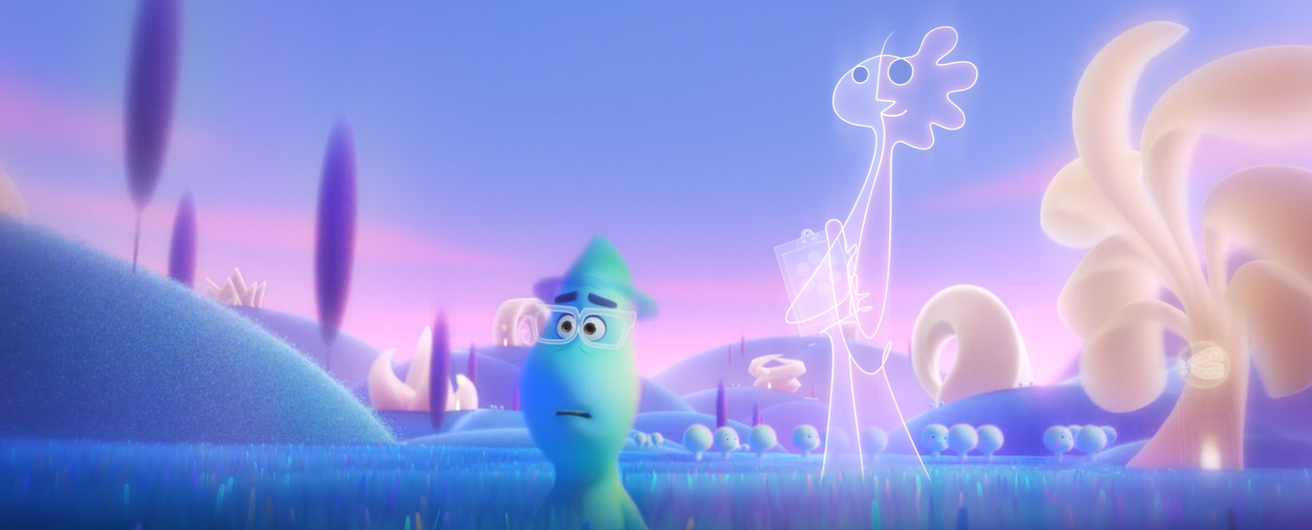
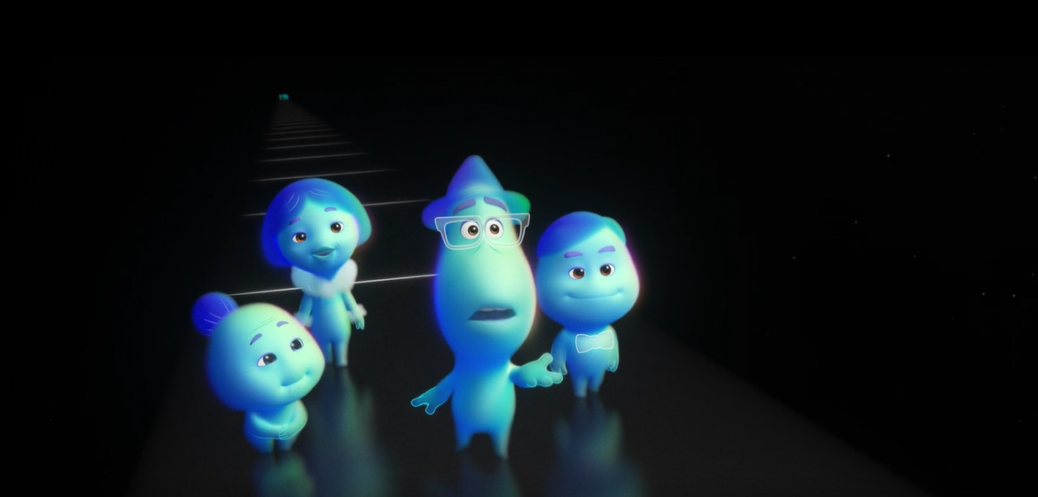
So what do you think you’ll do?
How are you gonna spend your life?
JOE: I’m not sure.
But I do know…
I’m going to live every minute of it.
Incredibly (Adv) /ɪnˈkred.ə.bli/
Unbelievably
Joe was incredibly shocked by his sudden death.
.

Slide 23
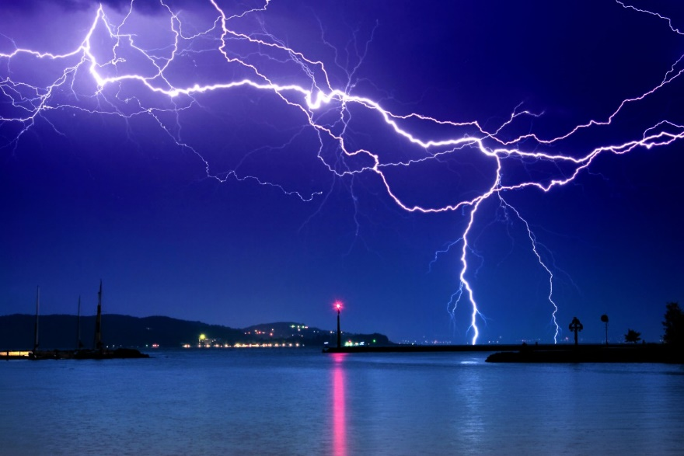
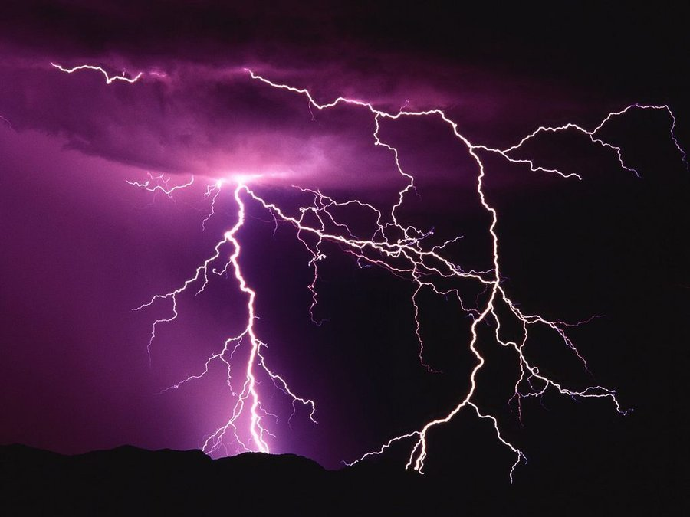
Lightning (N) /ˈlaɪt.nɪŋ/
a flash of bright blue in the sky that is the consequence of electrical discharge between a cloud and the ground
Thunder and lightning
That tree was struck by lightning.

Slide 24
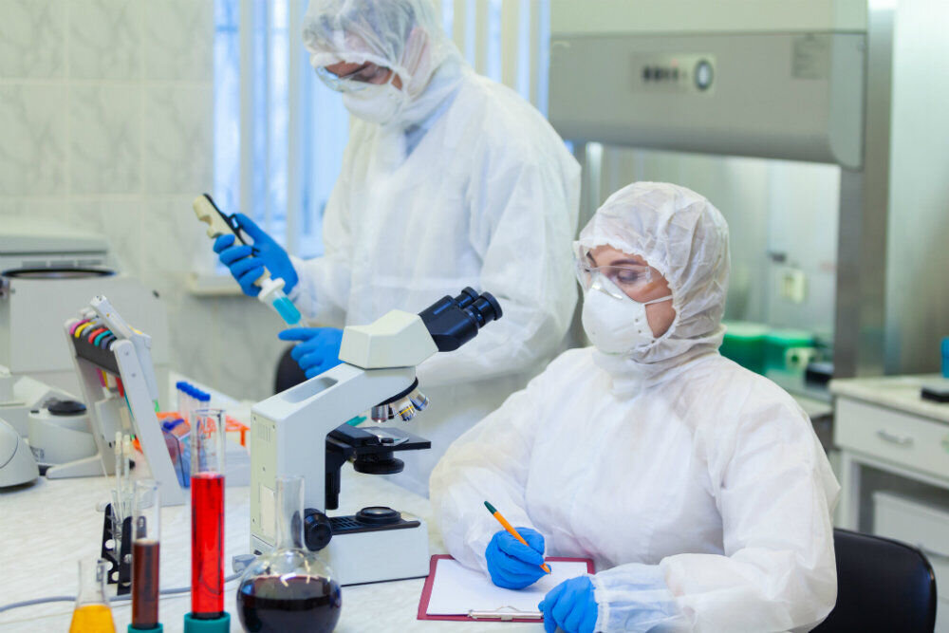
Scientists are working hard in the laboratories to produce COVID-19 vaccine.

Slide 25
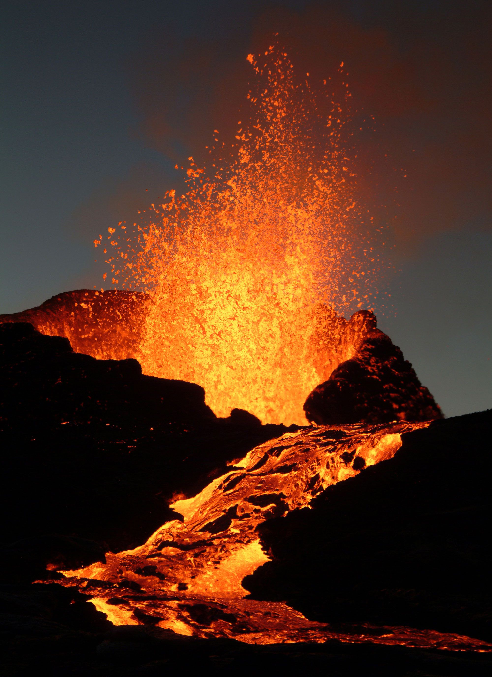
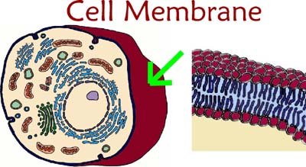
Molten (Adj) /ˈmoʊl.tən/
Molten metal/rock is in a liquid state because of great heat:
Molten lava
Membrane (N) /ˈmem.breɪn/
a very thin piece of material that covers an opening
A cell membrane

Slide 26
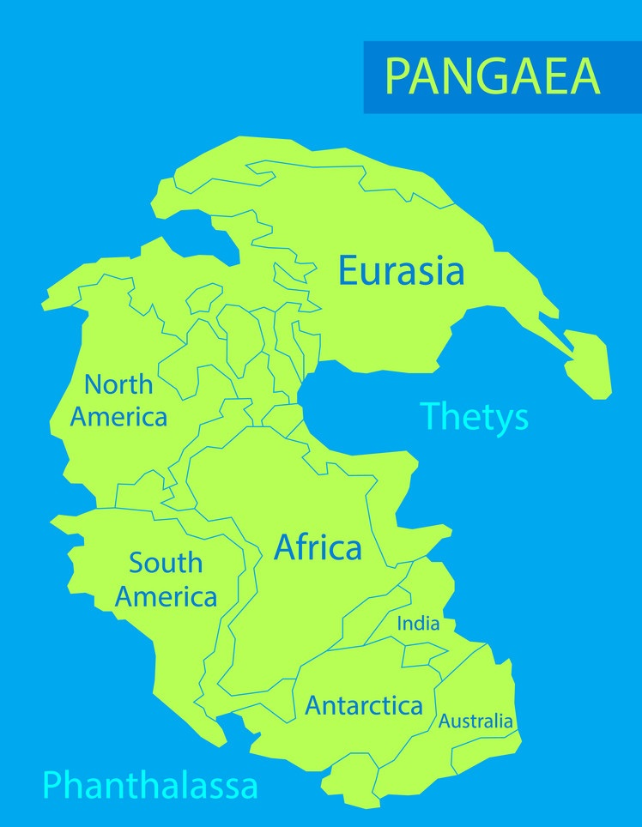
Pangaea (N) /pænˈdʒiː.ə/
the name given the one large area of land that began to break apart about 200 million years ago to create the present continents

Slide 27
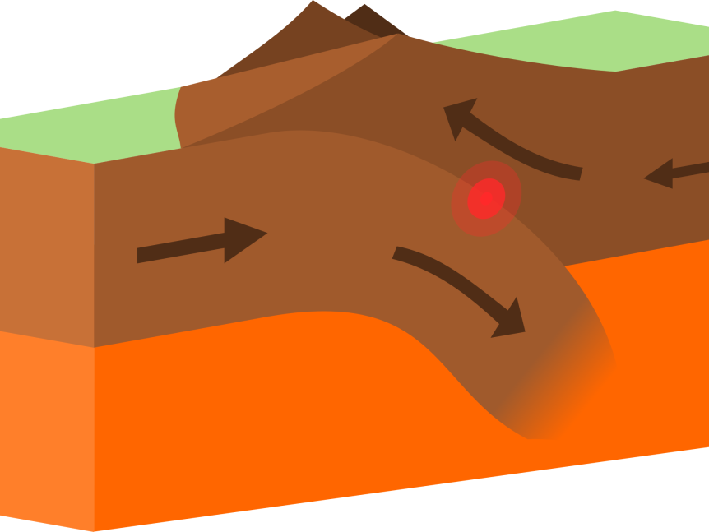
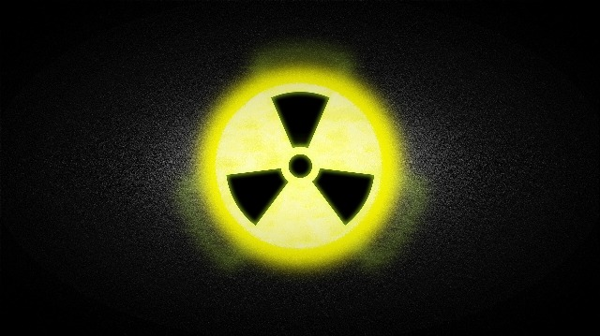
Plate tectonics (N) /ˌpleɪt tekˈtɑː.nɪks/
The study of how the surface of the Earth is formed, how the separate pieces of it move, and the effects of this movement
Radiation (N) /ˌreɪ.diˈeɪ.ʃən/
energy from heat or light that you cannot see:
Ultraviolet/ electromagnetic radiation
It is feared that people living near the power station may have been exposed to radiation.

Slide 28
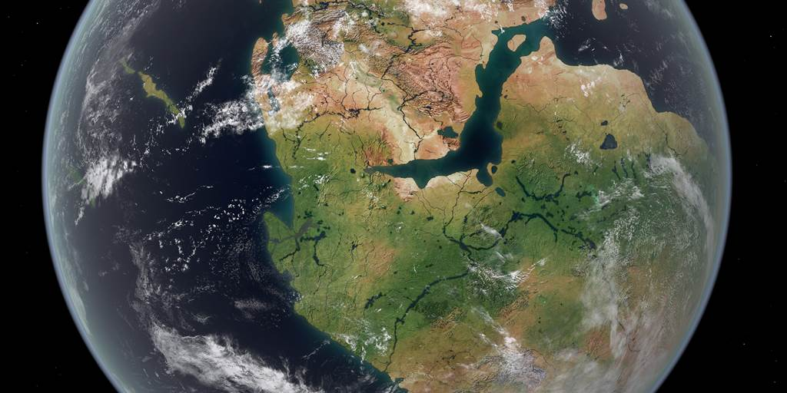
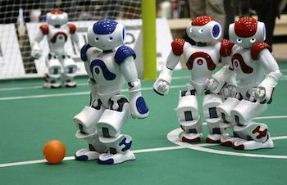
Rush apart
Reproduce (V) /ˌriː.prəˈdʒuːs/
To produce a copy of something
How is it possible to reproduce robots?

Slide 29
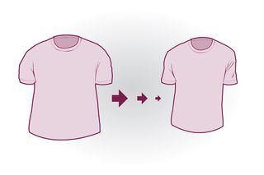
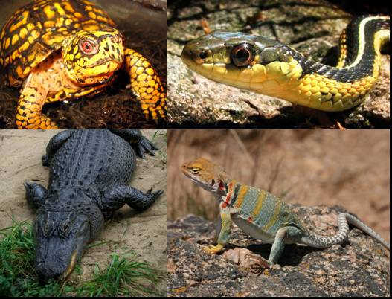
Reptile (N) /ˈrep.taɪl/
an animal that produces eggs and uses the heat of the sun to keep its blood warm
Shrink (V) /ʃrɪŋk/
to become smaller
Your sweater will shrink if you wash it at too high a temperature.

Slide 30
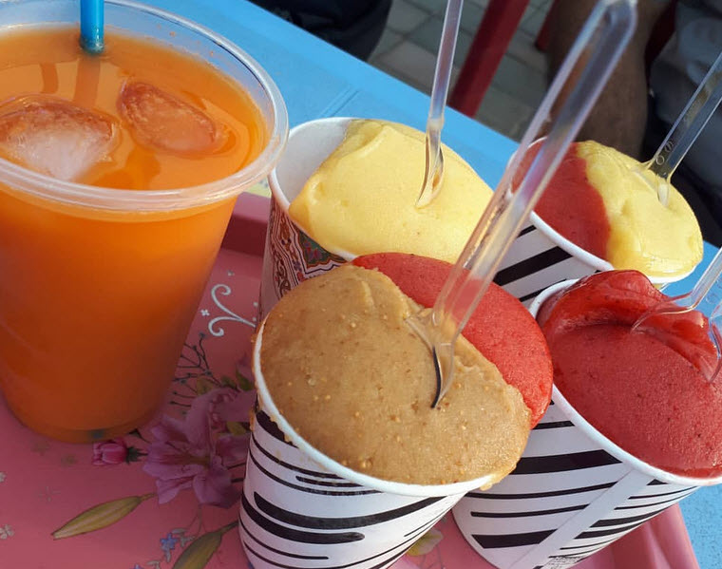
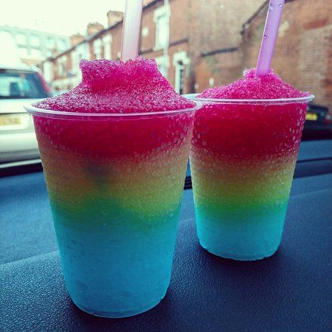
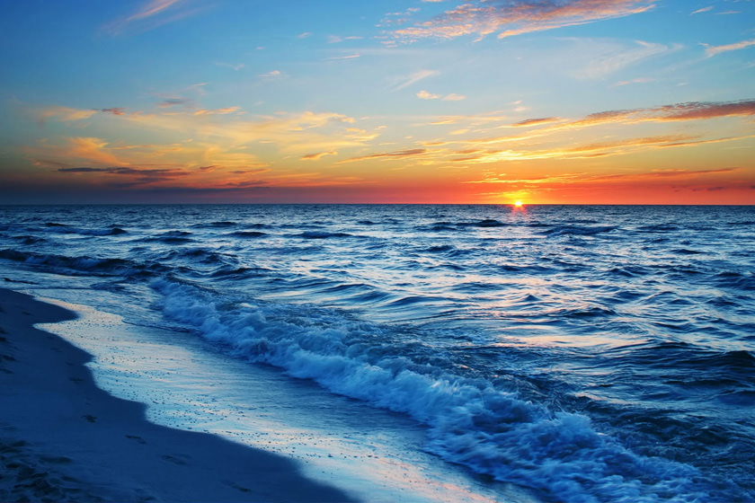
Slushy (Adj) /ˈslʌʃ.i/
Partly melted
Slushy snow is partly melted.
Surface (N) /ˈsəːfɪs/
The top part layer of something:
Neil Armstrong was the first person to set foot on the surface of the moon.
surface

Slide 31
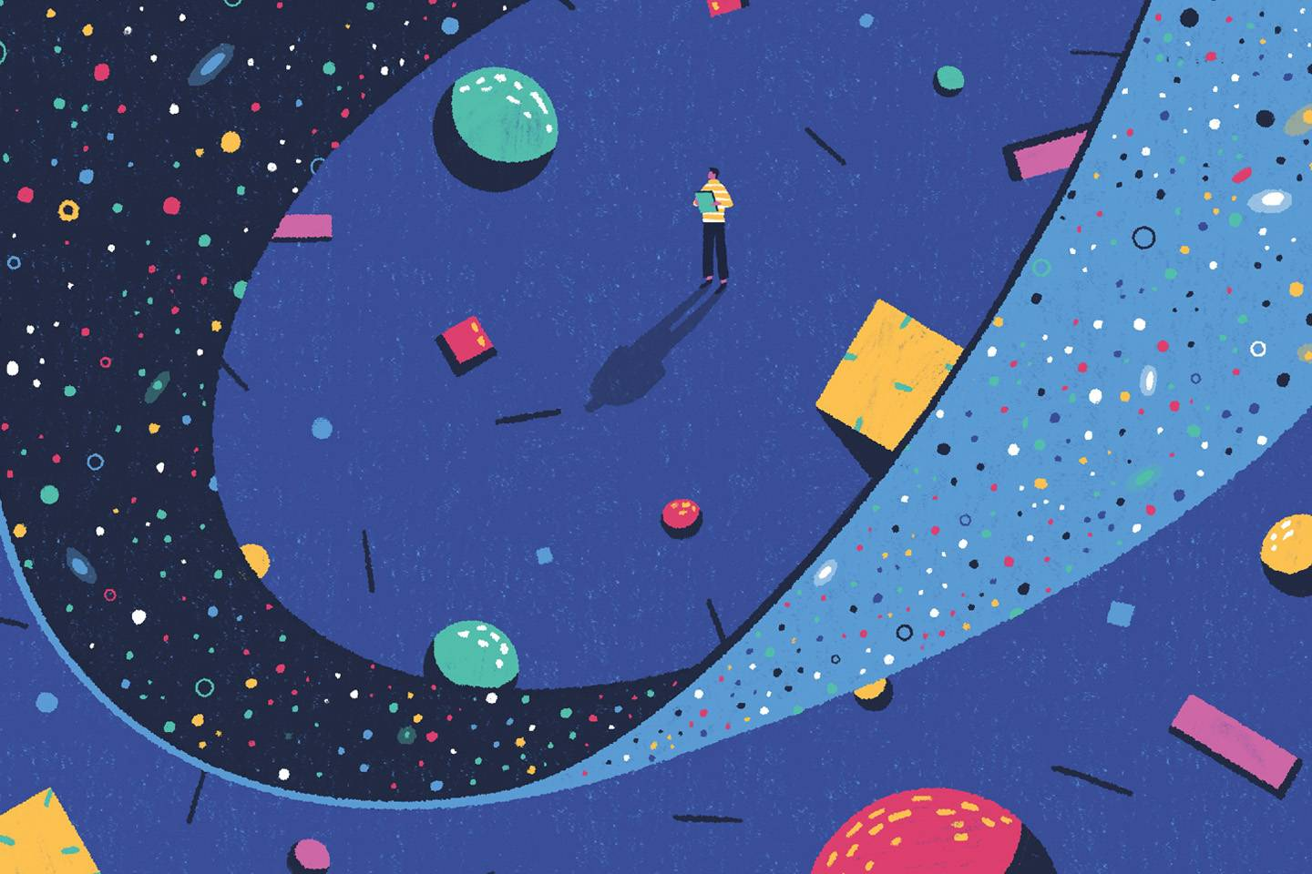

Universe (N) /ˈjuː.nə.vɝːs/
everything that exists:
Is there intelligent life elsewhere in the universe?
Substance (N) /ˈsʌb.stəns/
Material
Infectious substances

Slide 32



Raft (N)
/ræft/
A boat
Scrape (V) /skreɪp/
Remove a covering
Scrape ice
Plug (N)
/plʌɡ/

Slide 33


Volcano (N) /vɑːlˈkeɪ.noʊ/
a dormant volcano
an active volcano
Trigger (V) /ˈtrɪɡ.ɚ/
to make something happen
Monster students learn how to trigger fear.

Slide 34

Scrape: remove
Pull apart
Split apart

Slide 35



